Slide 1
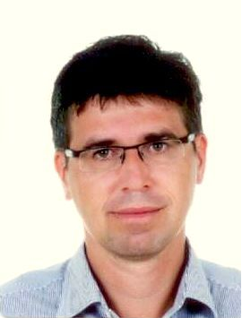
Transcranial Sonography in Parkinsonian Syndromes
25th Conference of the European Society of
Neurosonology and Cerebral Hemodynamics
David Školoudík
Ostrava University Medical Faculty, Czech Republic

Slide 2
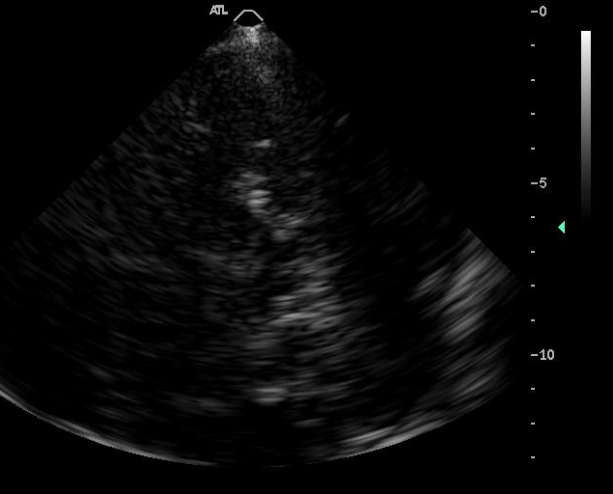
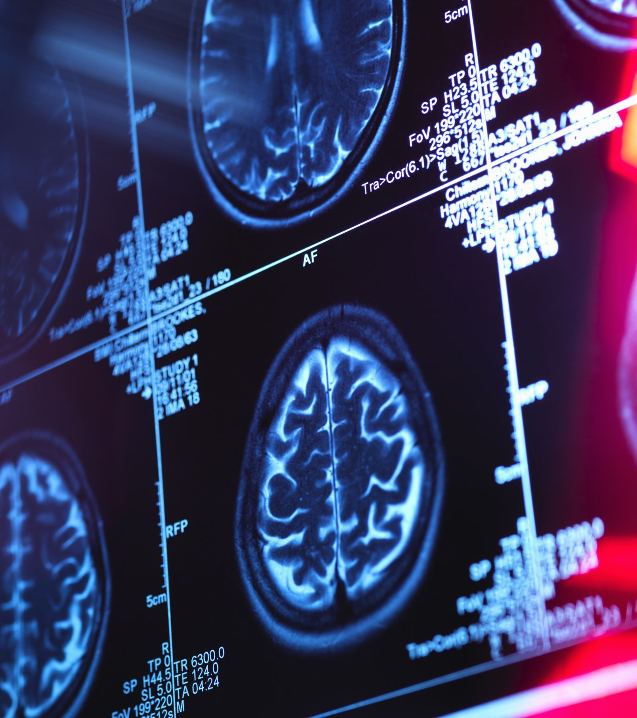
Transcranial sonography in parkinsonian syndromes
Transcranial sonography
- settings
- image evaluation
TCS findings in neurodegenerative diseases with Parkinsonian symptoms
Fusion Imaging
Digital Image Analysis

Slide 3
Machine settings
Settings depends on the ultrasound machine
Example for ESAOTE MyLab Twice:
penetration depth of 14 - 16 cm
high penetration
dynamic range = 45 - 55 dB
enhancement = 3
density = 2
view = 9
persistence = 7
dynamic compression = 0
gain = 36%
gray map = 0
S view off
two focuses at 5 and 10 cm
mechanical index = 0.9
tissue indices: TIs = 1.0, TIB = 1.0, and TIC 2.1

Slide 4
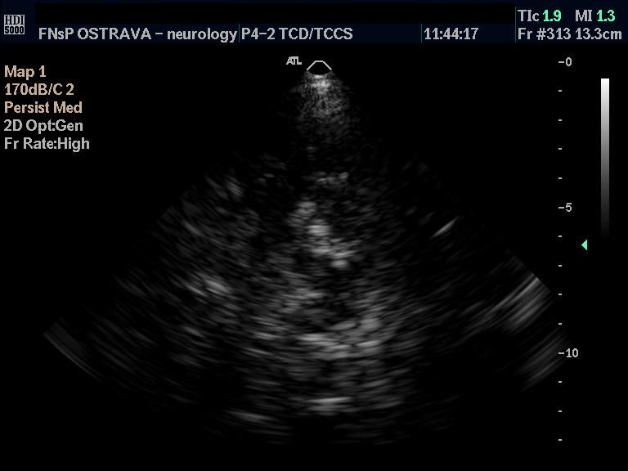

Slide 5
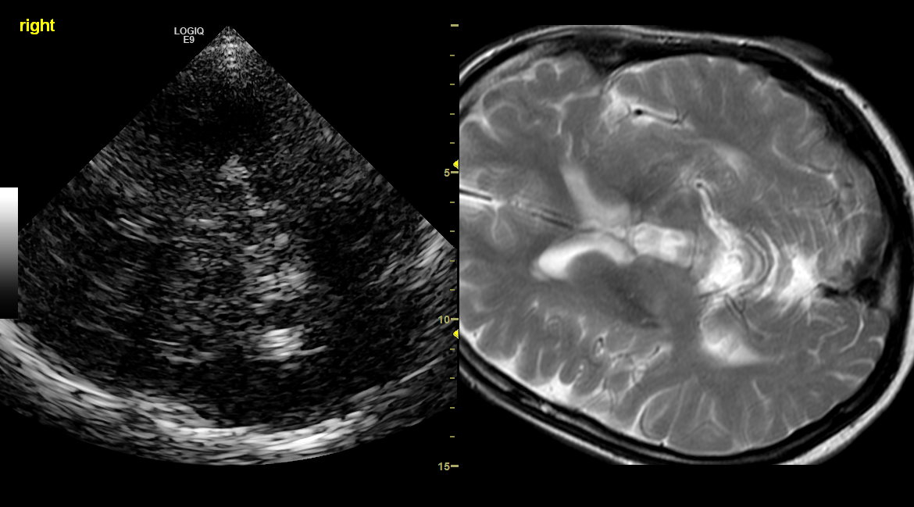
Image evaluation
Substantia nigra
Brainstem raphe
Red nucleus
Caudate nucleus
Lentiform nucleus
Thalamus
Insula
Dentate nucleus
Mediotemporal lobe
Cerebral and cerebellar white matter
Ventricles (3rd, 4th, lateral, frontal and occipital horns)

Slide 6
Substantia nigra

Slide 10
Substantia nigra
Optimal cut-off for differentiation between Parkinson´s disease and healthy population is the 90th percentile in the general population
90th percentile

Slide 11
Substantia nigra
It is not advisable to accept a threshold value from another neurosonology laboratory
90th percentile

Slide 12
Estimated distribution of SN area

Slide 13
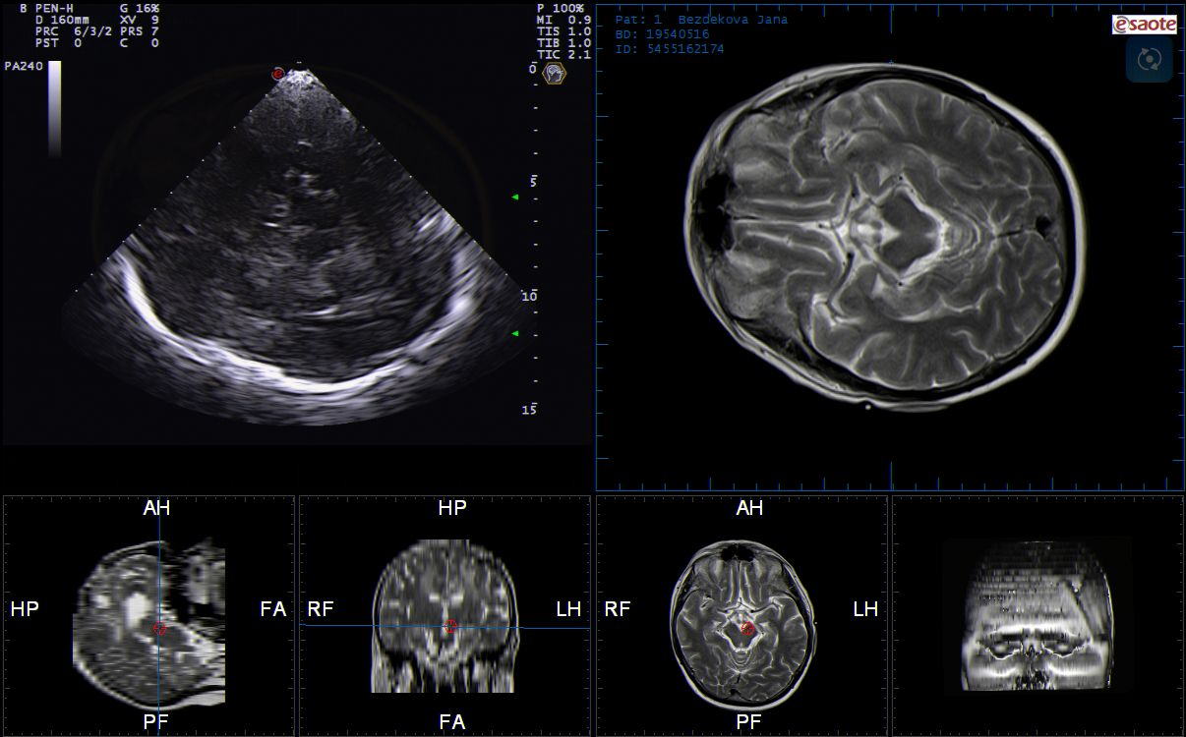
Brainstem raphe

Slide 16
Brainstem raphe
Normally visible as continual echogenic line dividing the brainsten to left and right halves
Pathological finding is discontinuous line or missing echogenic line
Optimal cut-off for differentiation between unipolar depression and healthy population is the 5th percentile in the general population
Pathological findings in unipolar depression and associated with suicidal ideation

Slide 17
Red nucleus

Slide 19
Red nucleus
Usually anechoic structure
Rarely red nucleus is visible as spherical echogenic structure
It has not yet been established whether the change in echogenicity is related to a specific brain disease

Slide 20
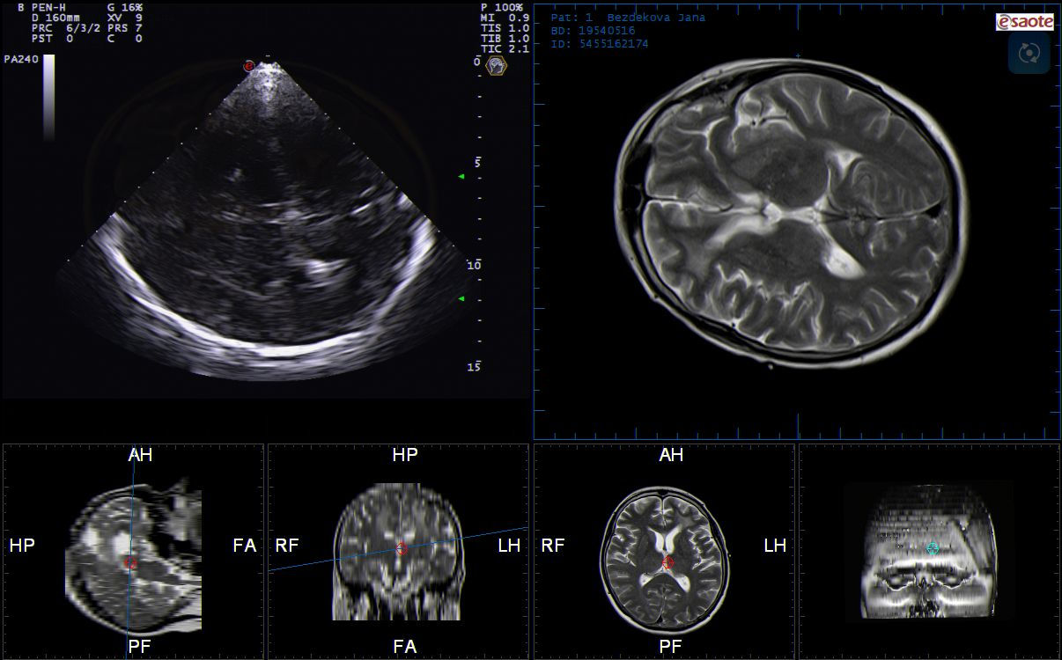
Caudate nucleus

Slide 23
Lentiform nucleus

Slide 25
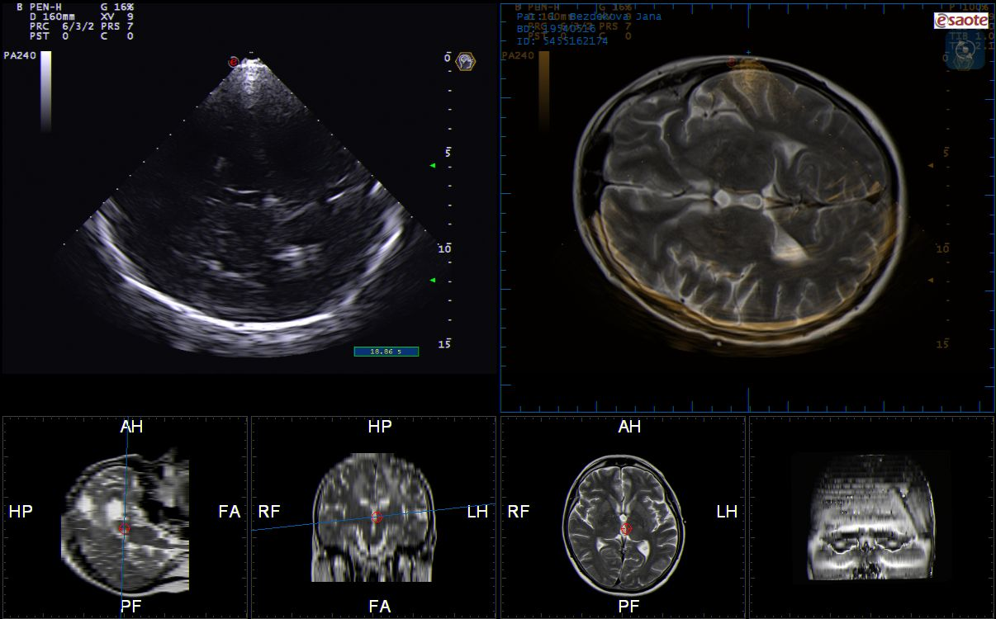
Thalamus

Slide 27
Insula

Slide 29
Caudate nucleus
Anechoic structure dorsally to the frontal horn of lateral ventricle delineated laterally by echogenic line
Hyperechogenic in some neurodegenerative diseases (e.g. Huntington´s disease, etc.)

Slide 30
Lentiform nucleus
Hypoechogenic structure dorsally to the caudate nucleus and medially to echogenic insula
Hyperechogenic in some neurodegenerative diseases (e.g. Wilson´s disease, dystonia, etc.)

Slide 31
Thalamus
Usually hypoechoic structure
Rarely thalamus is visible as echogenic structure
It has not been established yet whether the change in echogenicity is related to a specific brain disease

Slide 32
Insula
Echogenic „striped“ structure laterally to lentiform nucleus
Changes in echogenicity are detectable only using digital image analysis
Hyperechogenic in various neurodegenerative diseases (Wilson´a disease, Huntington´s disease, etc.)

Slide 33
Dentate nucleus

Slide 35
Cerebellar white matter

Slide 37
Dentate nucleus
Hypoechogenic structur in the cerebellum
Hyperechogenic in some neurodegenerative diseases (few types of spinocerebellar ataxia, etc.)

Slide 38
Cerebral white matter

Slide 40
Medial temporal lobe

Slide 42
Cerebral white matter and medial temporal lobe
Anechogenic structure
Hyperechogenic cerebral white matter in various brain diseases (lacunar infarctions, periventricular white matter lesions, etc.)
Atrophy of medial temporal lobe leads to changes in ration between echogenic and anechogenic structures

Slide 43
Ventricular system (3rd, 4th, lateral, frontal and occipital horns)

Slide 45
Ventricular system (3rd, 4th, lateral, frontal and occipital horns)
Standardly measurable only the 3rd ventricle
Normal diameter of the 3rd ventricle is < 8-10 mm (dependent on age)
Dilated ventricles in hydrocephalus – “shake test“ may be helpfull for distinguishing between normotensive and hypertensive hydrocephalus
Dilated 3rd and/or 4th ventricles RE typical for the progressive supranuclear palsy, spinocerebellar ataxia type 2, etc.

Slide 46
Evaluation of TCS examination
Evaluation has to be complex with evaluation of echogenicity of all visible structures and measurement of ventricular system

Slide 48
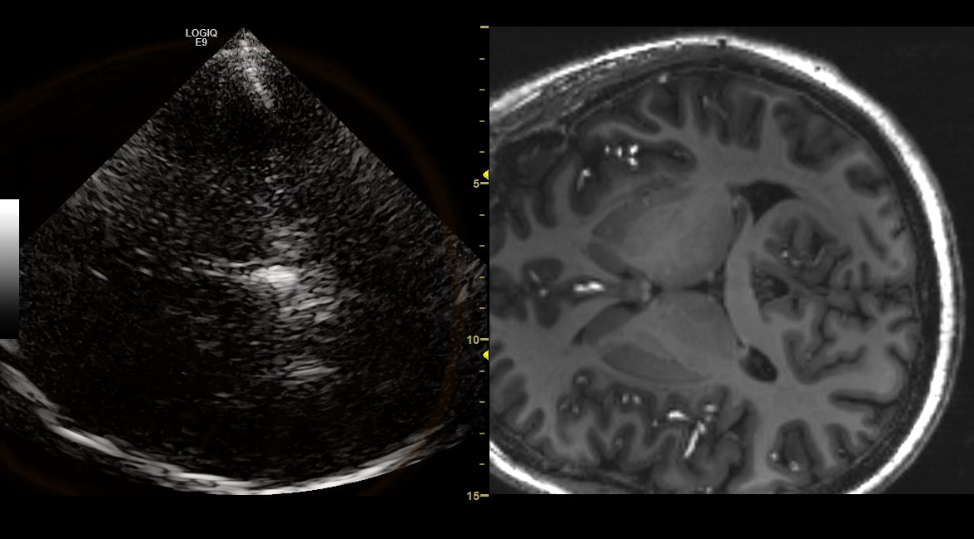
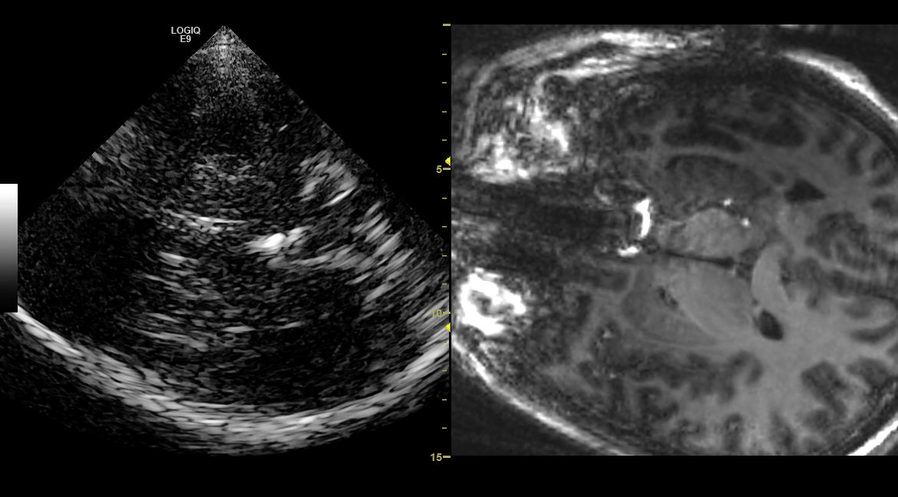

Slide 49
TCS findings in neurodegenerative diseases
TCS is able to detect changes in echogenicity of individual brain structures in various neurodegenerative brain diseases
Since 1995, tens to hundreds of TCS studies have been conducted
The most frequently studied structure is substantia nigra, especially in Parkinson´s disease

Slide 50
Parkinson´s disease
Hyperechogenic SN is detectable in approx. 90 % patients with PD, typically assymetric
Hyperechogenic SN does not correlate with age or disease duration
Hyperechogenic SN is changing very slowly in time
Hyperechogenic SN is detectable many years or decades prior to the first PD symptoms
Hyperechogenic SN in age of 50 – 70 years increase the risk of PD 20 times
The hyperechogenity might be caused by pathological vascularization, neurodegeneration and accumulation of iron
Berg et al., 2006, 2010, 2013; Walter U, Skoloudik D, 2013; Mijajlovic et al., 2014; ; Yilmaz R, et al., 2018

Slide 51
Essential tremor
SN hyperechogenicity is detectable slightly more frequent than in general population (10 - 18 %)
SN echogenicity is usefull for differentiation between PD and essential tremor (sensitivity 86%, specificity 93%, positive and negative predictive values 95 and 82%), optimally in combination with sniffin´ test and other tests.
Alonso-Ca´novas et al., 2014; Ba´rtova´ et al., 2014; Budisic et al., 2009; Chitsaz et al., 2013; Doepp et al., 2008; Kim et al., 2012; Luo, Zhang, Sheng, Fang, & Liu, 2012; Okawa et al., 2007; Richter et al., 2017; Stockner et al., 2007

Slide 52
Progressive supranuclear palsy
SN hyperechogenicity more frequent than in general population but less frequent than in Parkinson´s disease (14 – 73 %)
Midbrain structures atrophy with enlargement of third ventricle ˃10 mm
Hyperechogenicity of the lentiform nucleus
PSP–Richardson syndrome has a significantly higher prevalence of lenticular nucleus hyperechogenicity and a significantly wider third ventricle, whereas PSP–parkinsonism has a significantly higher prevalence of pathologic SN hyperechogenicity (73% versus 14%) with a significantly larger maximum SN area
Literature: Mijajlovic MD, et al. Transcranial Brain Parenchymal Sonography in Neurodegenerative and Psychiatric Diseases. J Ultrasound Med 2014; 33:2061–2068

Slide 53
Multiple system atrophy
SN hyperechogenicity is slightly more frequent than in general population (6 - 40 %)
Hyperechogenic lenticular nucleus (67–75%)
Normal ventricular system
Behnke, Berg, Naumann, & Becker, 2005; Fujita et al., 2016; Okawa et al., 2007; Walter et al., 2003; Bartova et al. 2016

Slide 54
Vascular parkinsonism
SN hyperechogenicity is slightly more frequent than in general population (10 - 50 %)
Frequent vascular pathology (e.g. increased PI and RI in MCA, arterial stenoses, occlusions, etc.)
Literature:

Slide 55
Lewy body disease
Billateral symmetric SN hyperechogenicity (assymetric index <1.15) (53 - 100 %)
Walter et al., 2006; Favaretto et al., 2016; Fernandes et al., 2011

Slide 56
Corticobasal degeneration
SN hyperechogenicity is detectable in majority of patients (67 – 86 %)
? Hyperechogenic lentiform nucleus
? Hyperechogenic caudate nucleus
More studies needed
Walter et al., 2004; Sadowski et al., 2015

Slide 57
Restless leg syndrome
? Reduced SN echogenicity
More studies needed

Slide 58
Neurodegeneration with brain iron accumulation (MPAN and PKAN)
No typical TCS finding
? Hyperechogenic SN
? Hyperechogenic lentiform nucleus
? Hyperechogenic insula
More studies needed
Skowronska M., et al., 2018; Skowronska M., et al 2020

Slide 59
Amyotrophic lateral sclerosis
SN hyperechogenicity is more frequent than in general population (19 – 40 %)
BR hypoechogenicity is 3times more frequent than in general population (28 %)
Slightly increased diameter of the third ventricle (by 20 %)
Pavlovic AM, et al., 2015, Preel T, et al., 2014

Slide 60
Wilson´s disease
Hyperechogenic lentiform nucleus (90 – 100 %)
Hyperechogenic insula (90 – 100 %)
? Slightly more frequent hyperechogenic substantia nigra (10 – 25 %)
Mašková J, et al., 2018; ; Walter U, et al., 2005; Walter U, et al., 2010

Slide 61
Huntington´s disease
Hyperechogenicity of caudate nucleus (13% - 57%)
Hyperechogenicity of lenticular nucleus (6% - 71 %)
Hyperechogenicity of insula (93 %)
Slighty more frequent SN hyperechogenicity compared with general population (22 - 27%)
Krogias et al., 2011, Postert et al., 1999; Lambeck et al., 2015, Skoloudik D, et al. Unpublished data

Slide 62
Dystonia
Hyperechogenicity of lenticular nucleus in patients with cervical dystonia (75 %), upper limb dystonia (83 %) and facial dystonia (13 %)
No pathological findings in secondary dystonia
Naumann et al., 1996; Gaenslen A, et al, 2010

Slide 63
Unipolar depression
Hypoechogenic brainstem raphe in patients with unipolar depression (50 – 70%)
Normal TCS findings in bipolar disorder or depression in multiple sclerosis
In depressed patients with suicidal ideations, hypoechogenicity of brainstem raphe is even more pronounced (86%) with the highest frequency of a completely invisible brainstem raphe (72%)
Becker et al., 1994; Walter et al., 2007, Mijajlovic et al, 2014

Slide 64
Spinocerebellar ataxia
Hyperechogenic SN in SCA type 2 (33 %) and type 3 (40 %)
Hyperechogenic dentate nucleus in SCA type 3 (33 %)
Hyperechogenic cerebellar white matter in SCA type 3 (7 %)
Hyperechogenic lenticular nucleus in SCA type 3 (28 %)
More frequently hypoechogenic brainstem raphe in SCA type 17
Mijajlovic et al., 2008; Postert et al., 2004; Naumann et al., 1996; Wolters et al., 2005

Slide 65
Alzheimer´s dementia
Mediotemporal atrophy score (choroidal fissure and temporal horn) is higher in Alzheimer´s disease and correlates significantly with the hippocampal volume
Rezzak Y, et al. Transcranial Sonography Findings in Alzheimer's Disease: A New Imaging Biomarker. Ultraschall Med 2020

Slide 66
Importance of TCS in neurodegenerative diseases
Risk factor for Parkinson´s disease
Diagnostics of Parkinson´s disease
Differential diagnosis between PD and essential tremor
? Differential diagnosis in parkinsonian symptoms
? Diagnostics and differential diagnosis in patients with symptoms of neurodegenerative diseases
? DBS implantation monitoring

Slide 67
Limitation of transcranial sonography
Inadequate bode window (2 – 25 % dependent on age and gender)
Lateral resolution is lower than axial one
Dependent on sonographer skills and experience
Dependent on ultrasound machine, settings and probe
Walter U, Skoloudik D. Transcranial Sonography (TCS) of Brain Parenchyma in Movement Disorders: Quality Standards, Diagnostic Applications and Novel Technologies. Ultraschall in Med 2014; 35:322–331

Slide 68
Fusion Imaging technique
Transcranial (color-coded dupex) sonography Fusion Imaging using Virtual Navigator enables real time (online) imaging of brain structures and brain vessels by duplex sonography and MRI/MRA, CT/CTA or PET-CT

Slide 69
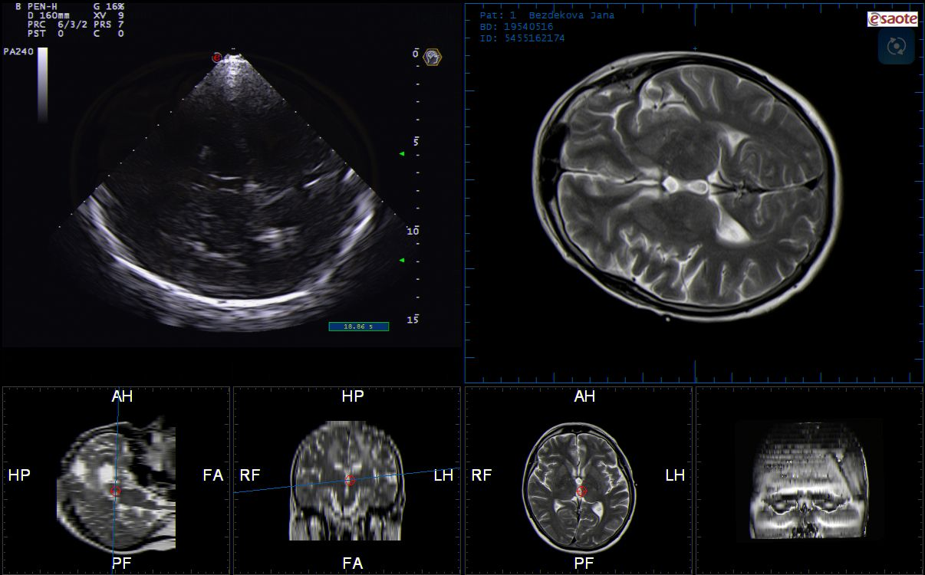

Slide 71
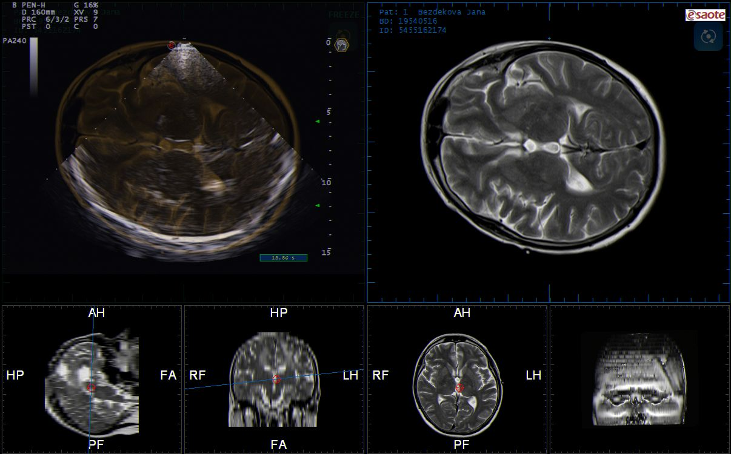

Slide 72
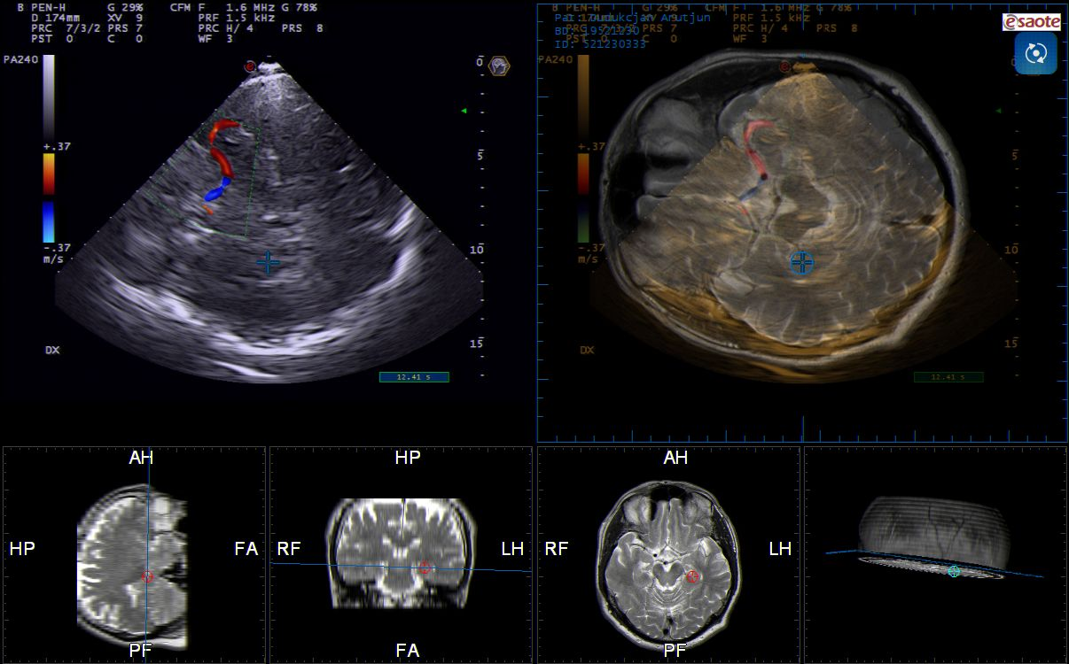

Slide 74
TCS (TCCS) Fusion Imaging technique is a new promissing diagnostic modality combining real time (online) TCS or TCCS with MRI, CT or PET-CT, PET-MRI.
This technique enables to evalute echogenicity of several brain structures and improve the diagnostics and differential diagnosis in patients with various neurological symptoms.

Slide 75
Digital Image Analysis
Semi-automatic or automatic detection of intracranial structures with quantitative evaluation of echogenicity (structure, composition) of predefined brain structures

Slide 76
Digital Image Analysis
enables to compare echogenicity of any predefined area of the brain between patients with severe neurodegenerative diseases and heathy subjects and also to monitor the changes of echogenicity of predefined brain structures during the course of disease (in defined time period)

Slide 77
Conclusion
Transcranial sonography is able to detect changes in echogenicity of various brain structures
Fusion Imaging technique and Digital Image Analysis enable accurate qualitative analysis of echogenicity of individual brain structures
Transcranial sonography is a promising cheap, non-invasive and well-reproducible method for the risk detection, diagnostics and differential diagnostics of various neurodegenerative diseases, including Parkinson´s disease and parkinsonian syndromes.

Slide 78
Thank you for your attention

